Slide 1


Evaluating Mortgage Lending Equity in the South Atlantic:
A CRA-Linked HMDA Analysis for NCRC
Johns Hopkins University Carey Business School
Team 10

Slide 2
Executive Summary
Data & Scope: 2022 HMDA merged with CRA data, South‑Atlantic (~932 k loans)
Does a CRA rating still guarantee fairer mortgage access and pricing — and for whom?
+22% on Black Applicant’s Approval Rate but creates new disparities among other race and ethnicity groups: Hispanic or Latino (-11%~-20%) & Native Hawaiian(-59%)
Mandatory disclosure to address racial gap
CRA backfired on low-income borrowers: approval rate 15.89 % (CRA) vs 22.60 % (non‑CRA)
Loan Assistance Programs
Black borrowers faced highest interest rate spread (+66.8 bps) even being benefited from higher approval rate from CRA-rated banks
Refinancing Options
Situation

Slide 3
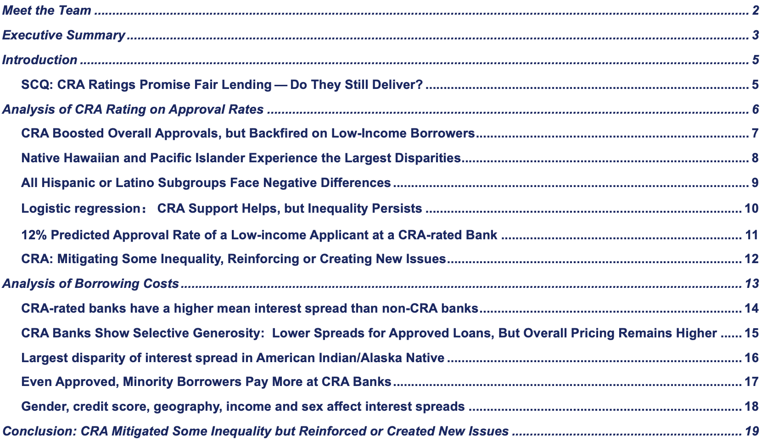
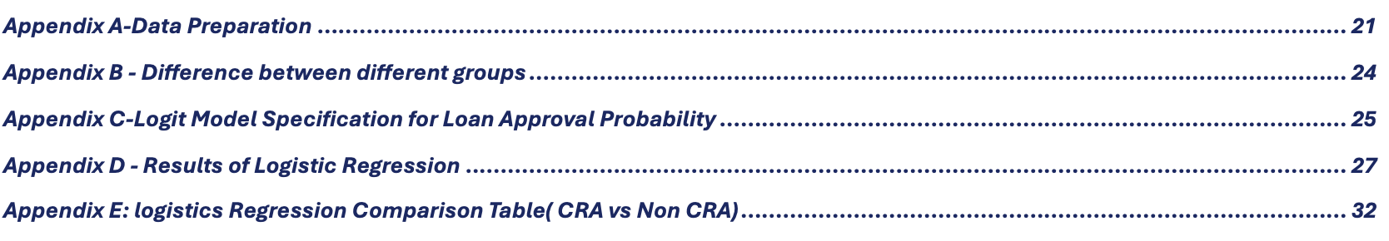
Table of Content
Notes:
Summary:Situation, Complication, Question & Key Findings
Approval Rate:Racial and Socioeconomic Gap on Approval Rate
Mortgage cost:Racial and Socioeconomic Gap on Interest Rate Spread

Slide 4
SCQ: CRA Ratings Promise Fair Lending — Do They Still Deliver?
Data & Scope: 2022 HMDA, South‑Atlantic (~932 k loans).
Purpose of CRA :
rates how well banks serve low‑ & moderate‑income & marginalised borrowers.
Why it matters to NCRC : CRA score is NCRC’s primary flag for fair‑lending gaps..
Situation
Complication
Key Questions
Overall approvals climb at CRA lenders (+12 pp).
Low‑income borrowers lag at CRA banks (-6.71 pp).
Cost gap widens: average rate‑spread at CRA banks increases (+0.30 pp).
Does a CRA rating still guarantee fairer mortgage access and pricing — and for whom?
We’ll test whether CRA helps or harms different communities and recommend how to close the gaps.
* pp” = percentage‑points; All figures CRA – non‑CRA; p < 0.001. Data prep & diagnostics in appendix.

Slide 5
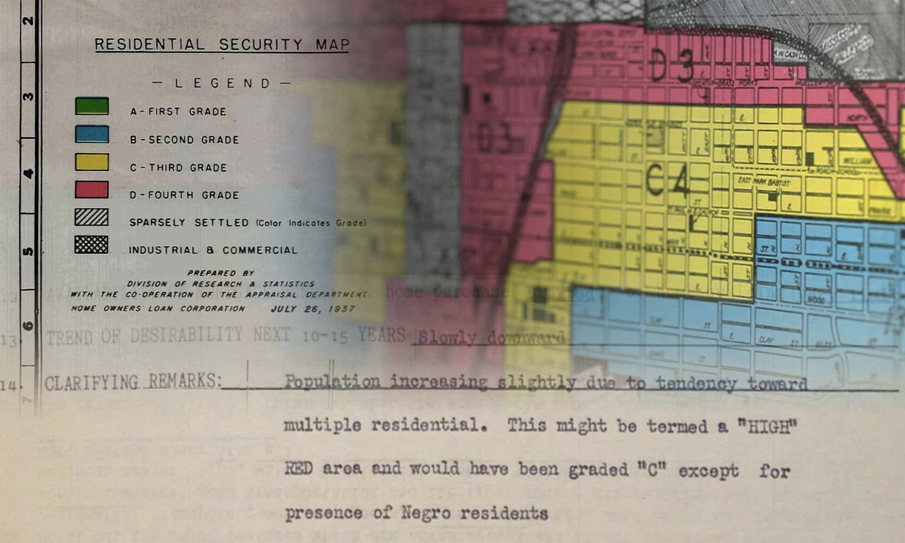
Analysis of CRA-rating on Approval Rates

Slide 6
CRA Boosted Overall Approvals, but Backfired on Low-Income Borrowers
Applications to CRA-rated institutions are 11.78% more likely to be approved than those to non-CRA lenders (p < 0.001).
41 % (CRA) vs 29 % (non-CRA)
This appears to validate CRA's intended effect—but only at the surface level.
CRA Underperforms on Low-income Applicants
CRA Significantly Increases Overall Approval Likelihood
Low-income borrowers are 6.71% less likely to be approved by CRA institutions compared to non-CRA lenders (p < 0.001).
15.89 % (CRA) vs 22.60 % (non‑CRA)
While CRA improved access broadly, it fails to serve high-risk communities most in need.
Raises Concerns:
Some non-CRA lenders—such as nonbanks—may approve more loans, but under predatory conditions.

Slide 7
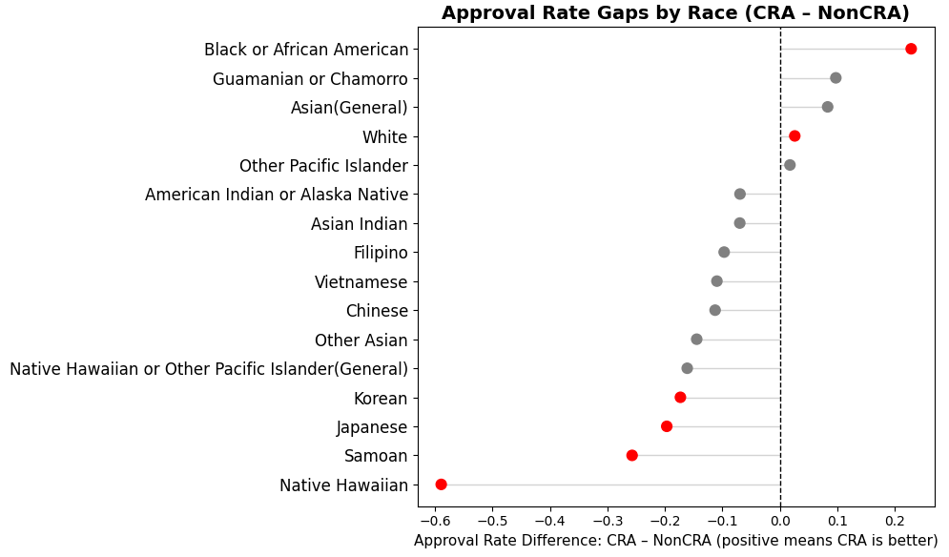
Native Hawaiian and Pacific Islander Experience the Largest Disparities
Racial disparities persist—even under CRA.
Native Hawaiian and Pacific Islander applicants experience the largest approval rate gap (59% less likely) between CRA and non-CRA institutions.
While Black applicants saw modest gains under CRA (+22.8%), groups like Japanese and Korean borrowers experienced significantly lower approval rates.
Race | Difference(CRA – Non-CRA)
Native Hawaiian | 0.589286
Samoan | 0.257143
Japanese | 0.196796
Korean | 0.173077
Black or African American | + 0.228523
Note: Difference = CRA approval rate – Non-CRA approval rate

Slide 8
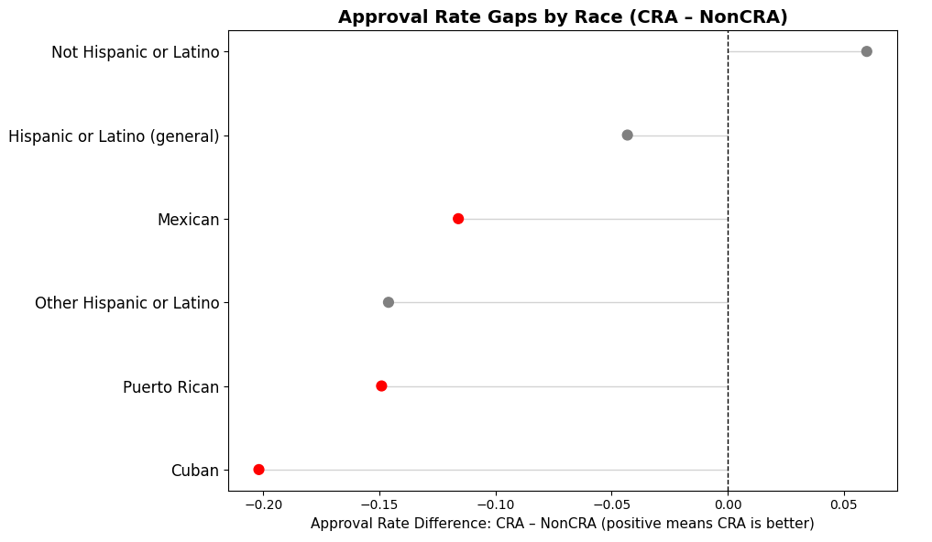
All Hispanic or Latino Subgroups Face Negative Differences
All Hispanic or Latino subgroups face negative differences, with Cubans experiencing the largest gap at - 20%.
Puerto Rican, Other Hispanic/Latino, and Mexican applicants also show consistent disadvantage, though to varying degrees.
These patterns suggest systemic ethnic disparities that warrant further investigation.
Ethnicity | Difference
Cuban | -0.201906
Puerto Rican | -0.149075
Other Hispanic or Latino | -0.146093
Mexican | -0.116011

Slide 9
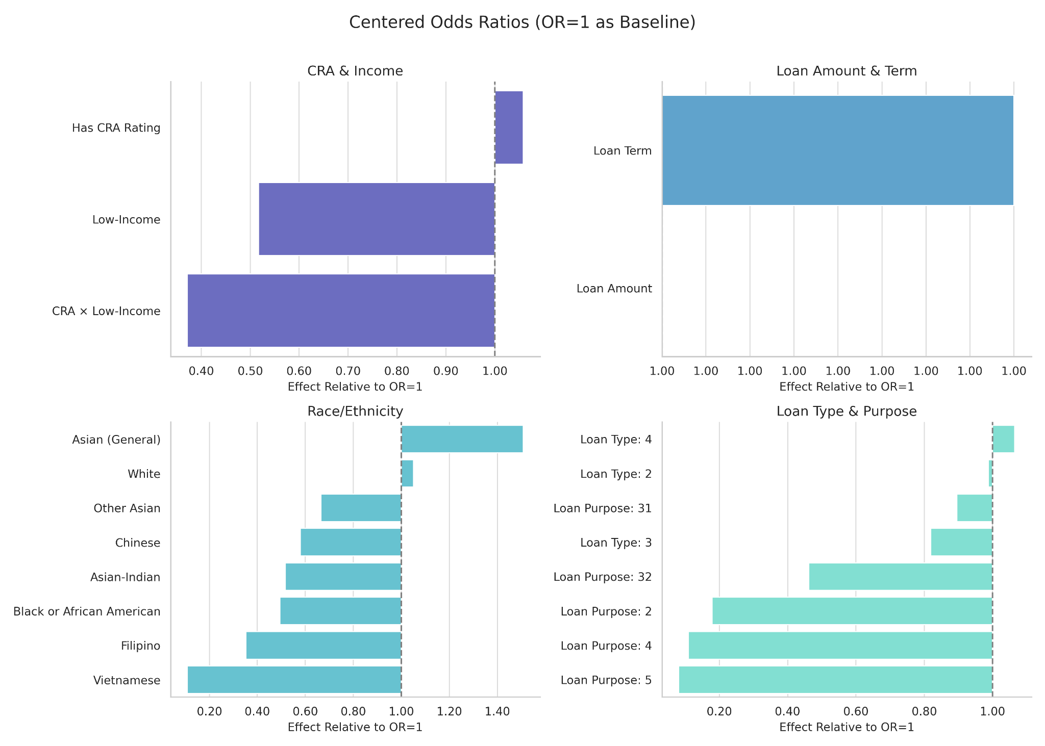
CRA Support Helps, but Inequality Persists
Odds Ratios Based on Logistic Regression (All Datasets)
After controlling ten different variables, we found
CRA helps a little (OR ≈ 1.06) — but not enough
Being low-income cuts approval odds in half (face ~50% lower odds of approval (OR ≈ 0.52))
CRA banks don’t fully protect low-income borrowers (CRA × Low-Income OR ≈ 0.37)
Race still matters:
Filipino, Black, and especially Vietnamese applicants experience the sharpest approval gaps
Vietnamese applicants face nearly 90% lower odds
Note:
1. We use a logistic regression model controlling for loan amount, loan term, loan type, loan purpose, and geographic fixed effects to isolate the impact of CRA affiliation, income level, and race/ethnicity on loan approval.
2. Odds Ratio (OR) = e^(coef). OR > 1 indicates an increased probability of approval; OR < 1 indicates a decreased probability of approval; OR = 1 indicates no effect on approval probability.
3. For model, LLR pvalue: 0.000; Log-Likelihood: -2.6036e+05; Pseudo-R-squared: 0.1443

Slide 10
12% Predicted Approval Rate of a Low-income Applicant at a CRA-rated Bank
We defined a baseline borrower profile by setting:
Loan amount and term: Sample Medians
Applicant sex, race, loan type, loan purpose:
Most Frequent Categories
MSA, open-end line, balloon payment, interest-only:
Most Frequent
After controlling these variables, CRA may benefit middle- and high-income applicants, but potentially disadvantage low-income individuals.
Non-CRA Prediction
CRA Prediction
CRA - Non CRA
Non-Low Income
40.9%
38.7%
2.2%
Low Income
12.3%
26.7%
-14.4%
28.6%
12%
16.6%
Gap
(Non-low - Low)

Slide 11
CRA: Mitigating Some Inequality, Reinforcing or Creating New Issues
Due to sample imbalance, we ran separate regressions for the CRA and non-CRA subsamples.
CRA helps improve access for some underserved groups.
Black and Asian borrowers face significantly higher approval odds at CRA-rated institutions compared to non-CRA lenders (e.g., OR ↑3.24).
CRA may introduce new disparities.
Native Hawaiian and Other Pacific Islanders appear to be more disadvantaged at CRA institutions (OR = 0.22 vs 1.10), suggesting that CRA benefits are not evenly distributed.
 | CRA OR (exp) | Non-CRA OR (exp) | CRA OR/Non-CRA OR
Black or African American | 1.18 | 0.36 | 3.24 ⬆
Asian (General) | 1.73 | 1.24 | 1.39 ⬆
Native Hawaiian and Other Pacific Islander (General) | 0.22 | 1.10 | 0.20 ⬇
White | 1.74 | 1.28 | 1.36 ⬆
CRA isn’t a failure — but it’s incomplete.

Slide 12
Analysis of Borrowing Costs After Approval

Slide 13
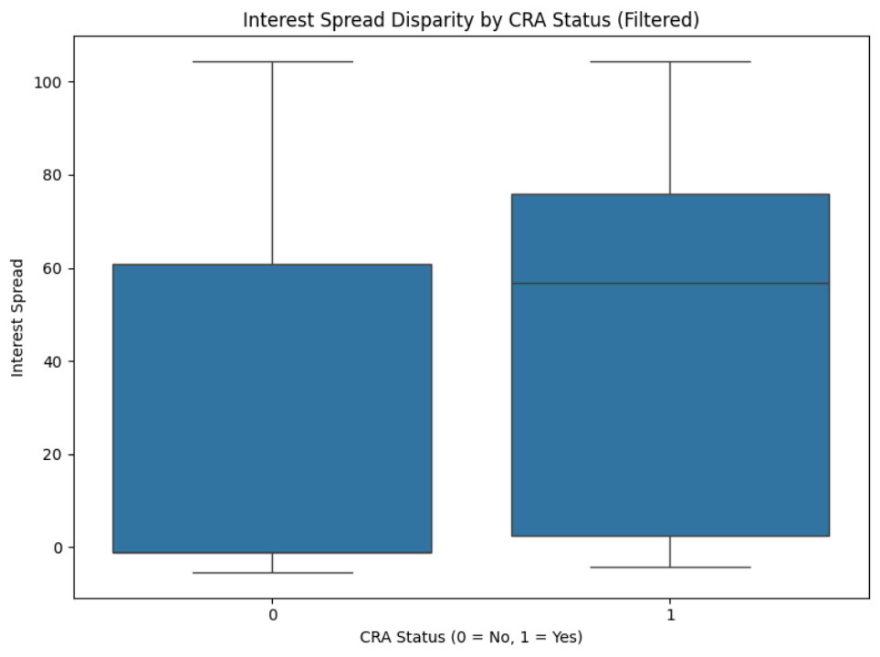
CRA-rated banks have a higher mean interest spread than non-CRA banks
T-test Result
Mean Interest Spread (CRA = 1): 53.87 bps
Mean Interest Spread (CRA = 0): 24.07 bps
T-statistic = 28.90, p-value < 0.001 → Statistically significant
💡 Why might CRA-rated banks charge more?
Higher-risk borrower mix: CRA banks may serve more low-income or underserved clients, raising average spreads.
Signals disparity: Sets the stage to examine spread differences by race—even among approved loans.
Notes:
NEED more cleared picture

Slide 14
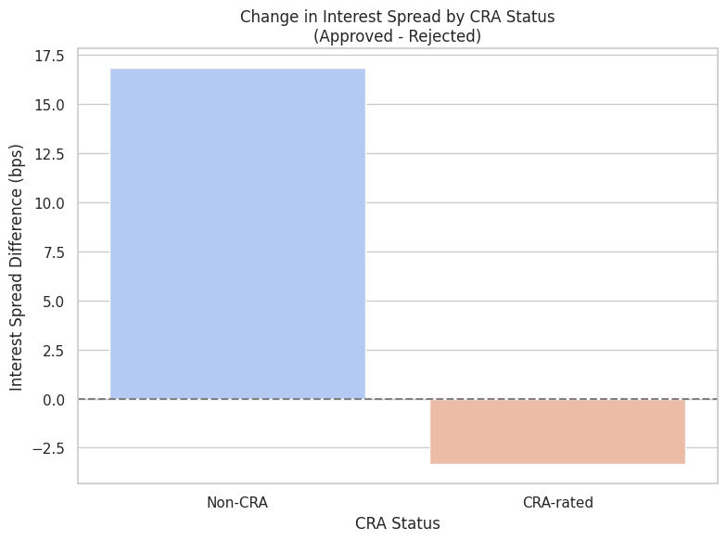
CRA Banks Show Selective Generosity: Lower Spreads for Approved Loans, But Overall Pricing Remains Higher
Comparison Result
Non-CRA banks increase interest spread by ~17 bps after approval — implying that approved borrowers pay more than rejected ones on average.
CRA-rated banks, however, show a decrease in spread (about −2.5 bps) after approval — meaning they may offer better terms to approved borrowers.
Showing that
Non-CRA institutions appear to penalize approved borrowers more heavily with higher spreads.
CRA institutions seem more generous post-approval—but earlier their overall spreads are still higher.
Raises Concerns:
Generosity is selective and may mask disparities across borrower types
Notes:
NEED more cleared picture

Slide 15
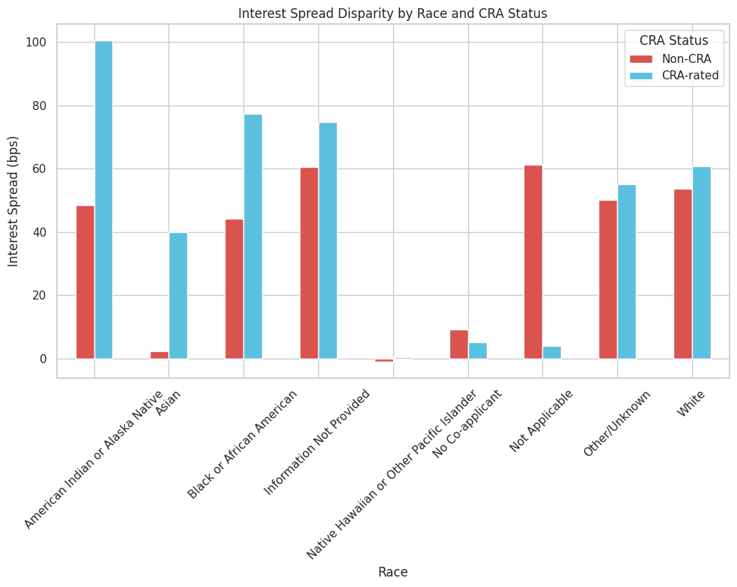
Largest disparity of interest spread in American Indian/Alaska Native
Key Insights
CRA-rated banks charge higher interest spreads than non-CRA banks across most racial groups.
The widest disparity is observed in American Indian/Alaska Native applicants — over +50 bps higher under CRA banks.
Black and Asian: notable increase, with CRA spreads exceeding 60–75 bps.
White applicants experience a smaller gap (CRA: ~60 bps, Non-CRA: ~53 bps), but the trend still holds.
The pattern is systemic, suggesting CRA status may not ensure equitable lending outcomes.
Notes:
NEED more cleared picture

Slide 16
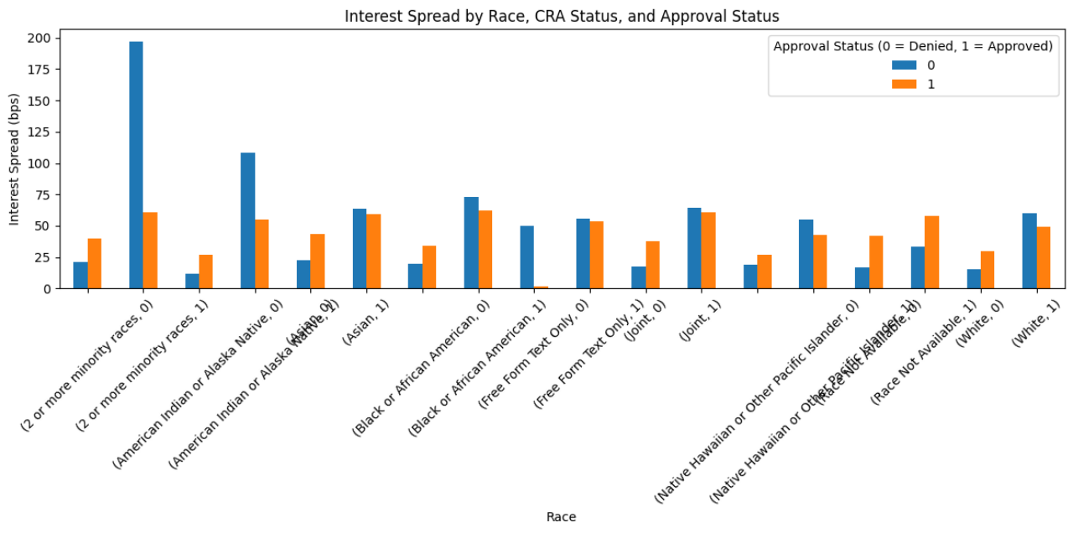
Even Approved, Minority Borrowers Pay More at CRA Banks
Confirmed after T-test
Even after approval, CRA-rated banks continue to charge higher spreads across most racial groups.
2+ Minority Races, American Indian/Alaska Native, Black, Asian, and Pacific Islander borrowers all exceed the 60 bps threshold.
The trend persists regardless of loan approval, signaling systemic pricing disparities—not just risk-based decisions.
Notes:
NEED more cleared picture

Slide 17
Gender, credit score, geography, income and sex affect interest spreads
CRA banks consistently charge higher spreads among all racial groups, especially to minority groups.
Race-CRA interactions are statistically significant, showing systemic pricing disparities.
Gender, credit score, geography, and income also affect interest spreads.
Sex appears to play a role in pricing — especially when missing/unknown, rates increase sharply.
Factor | Effect on Spread | Interpretation
Low Credit Score | ⬆ (e.g., T.3–T.5) | Risk-based pricing pattern
Missing Gender / Unknown | ⬆ Spike | Data gaps trigger pricing penalties
State (DE, GA, MD, NC) | ⬆ | Regional structural disparities
Loan Amount | +3.87 bps per unit ⬆ | Larger loans costlier
Neighborhood Income (MSA %)↓ | −0.010 per unit ⬇ | Lower income areas face higher spreads
Loan Approval | +4.71 bps | Approved loans slightly more expensive
Notes:
Our OLS model confirms the visual patterns.
Pricing is shaped not just by race and CRA status, but also by credit scores, geography, and income.
Borrowers from certain states or with missing sex data pay more — even if their credit scores are the same.
So approval alone does not guarantee fairness and these pricing gaps aren’t just about risk. They reflect broader structural factors for further explorations.

Slide 18
CRA Mitigated Some Inequality but Reinforced or Created New Issues
22% Improvement
on Black Applicant’s Approval Rate
CRA ratings significantly improve approval rates, especially for Black or African American applicants but creates new disparities among other race and ethnicity groups:Hispanic or Latino (-11%~-20%) & Native Hawaiian(-59%).
Mandatory disclosure to address racial gap
88% Denied
Predicted Probability of Low-income Applicant from CRA Lender
CRA may benefit middle- and high-income applicants, but potentially disadvantage low-income individuals.
Loan Assistance Programs
CRA failed to control mortgage costs as CRA-rated banks charged more after controlling race and approval status.
Refinancing Options
+54 bps vs +24 bps
CRA-rated interest spread vs non-CRA-rated interest spread
 | White | Black | Native American | Asian
Interest Spread Difference | +2 bps | +66.8 bps | +43.8 bps | +41.8bps

Slide 19


Thank you!
Please reach out with any questions!

Slide 20
Appendix A-Data Preparation
Steps of Merging:
1. Filter and Prepare CRA Data
Chunk the data for more efficient processing and dropped the columns with more than 50% missing value
Focused on South Atlantic (SA) states using FIPS-to-abbreviation mapping
Calculated average CRA rating per bank.
Filtered to banks with at least one exam in SA states.
Standardized bank names for matching.
2. Prepare LEI Data for Matching
Standardized respondent names from LEI data.
Created a unique set of respondent names for fuzzy matching.
3. Fuzzy Match Bank Names
Matched LEI respondent names to SA banks using fuzzywuzzy with token set ratio ≥ 85.
Merged successful matches with average CRA ratings.
4. Merge CRA Ratings into LEI Data
Merged CRA ratings into the full LEI dataset via standardized name key (resp_key).

Slide 21
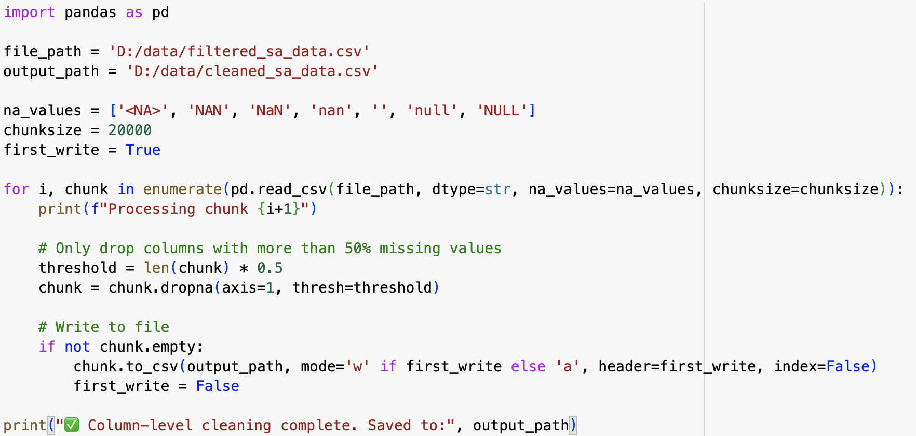

Slide 22
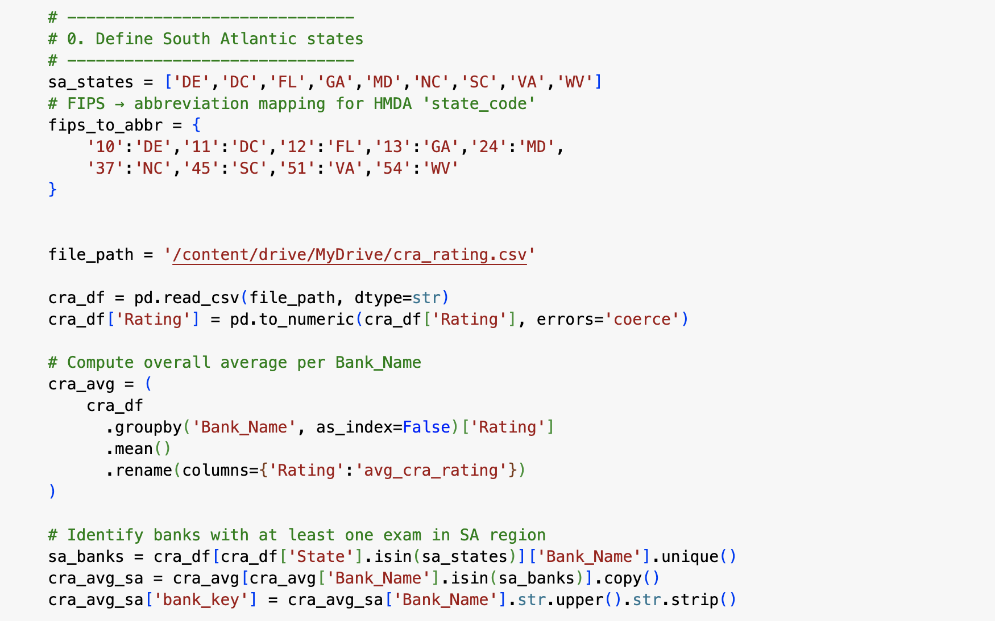
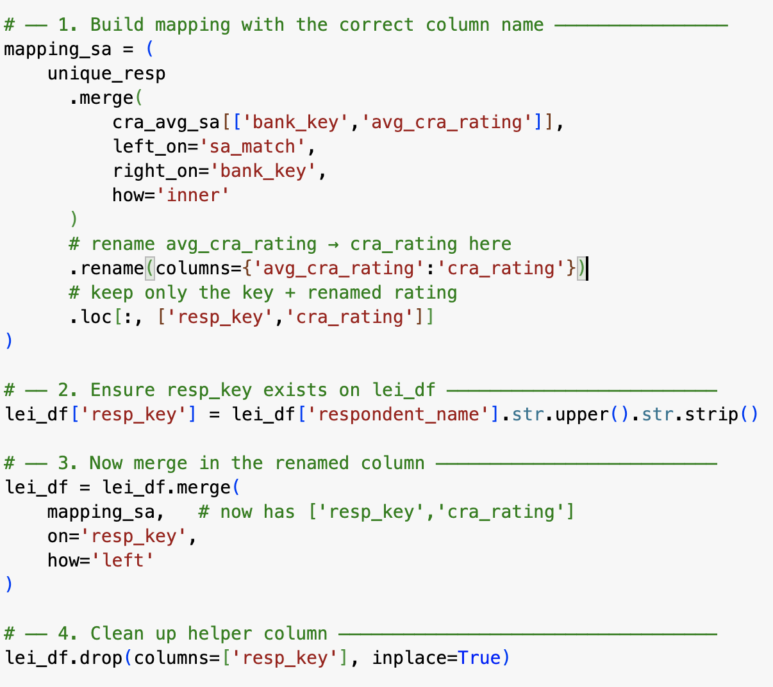
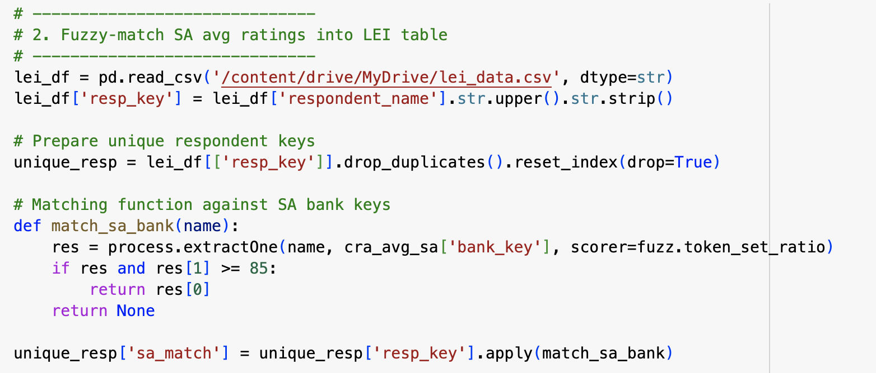

Slide 23
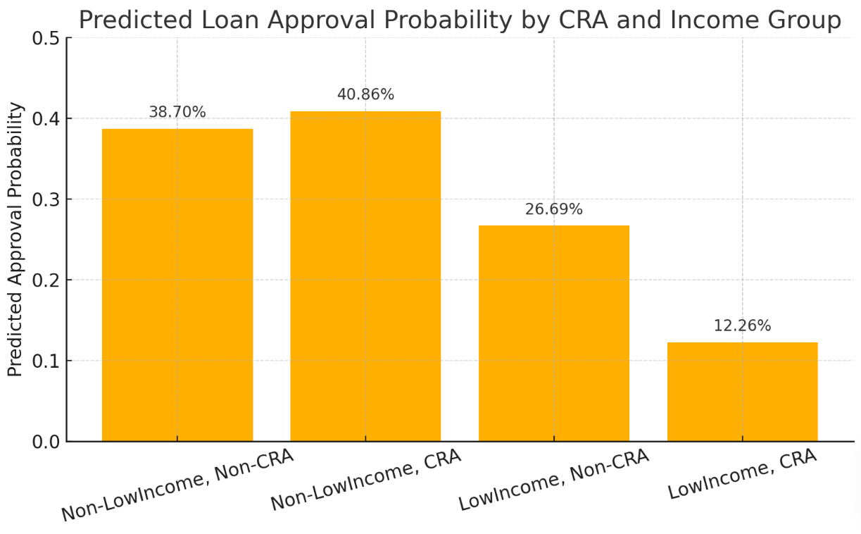
Appendix B - Difference between different groups
Low Income
CRA‑rated: 15.89%
Non‑CRA‑rated: 22.6%
T‑statistic: -22.063
p‑value: 1.01e-106
CRA‑rated approval rate: 40.67%
Non‑CRA‑rated approval rate: 28.89%
T‑statistic: 100.1487
P‑value: 0.0000
Group/Prob | CRA Prediction | Non-CRA Prediction | CRA - Non CRA
Non-low Income | 40.9% | 38.7% | +2.2%
Low Income | 12.3% | 26.7% | –14.4%
Gap (Non-low - Low) | + 28.6% | +12% | +16.6%

Slide 24
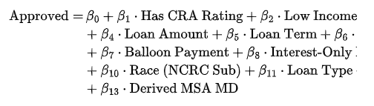
Appendix C-Logit Model Specification for Loan Approval Probability
Where:
Has CRA Rating refers to the presence of a CRA rating.
Low Income indicates whether the applicant is classified as low-income.
CRA Low Income is an interaction term between CRA rating and low-income status.
Loan Amount and Loan Term are continuous variables representing the amount of the loan and its term length.
Open-End Line of Credit, Balloon Payment, Interest-Only Payment are categorical variables indicating specific features of the loan.
Applicant Sex, Race, Loan Type, Loan Purpose, Derived MSA MD are categorical variables corresponding to the applicant’s sex, race (as per NCRC subcategories), loan type, loan purpose, and geographical region.

Slide 25
1. CRA & Income-Related Factors
has_cra_rating: Whether the loan was issued by a CRA-rated institution
low_income: Whether the applicant is low-income
cra_low_income: Interaction term between CRA and low-income status
2. Loan Amount & Term
loan_amount: Total amount of the loan application
loan_term: Duration of the loan in months
3. Loan Product Features
open_end_line_of_credit: Whether the loan is an open-end credit line
balloon_payment: Whether the loan includes a balloon payment structure
interest_only_payment: Whether the loan requires interest-only payments
4. Applicant Demographics
applicant_sex: Applicant’s gender
race_ncrc_sub: Applicant’s race or ethnicity subgroup
5. Loan Type & Purpose
loan_type: Type of loan (e.g., conventional, FHA)
loan_purpose: Purpose of the loan (e.g., home purchase, refinance)
6. Geographic Controls
derived_msa_md: Metropolitan statistical area (MSA) fixed effects

Slide 26
Appendix D - Results of Logistic Regression
Variable | Coefficient (p-value) | Interpretation
has_cra_rating | +0.0568 (p < 0.001) | CRA rating is positively associated with approval, even after controlling for other factors.
low_income | -0.6605 (p < 0.001) | Low-income applicants are significantly less likely to be approved.
cra_low_income | -0.9908 (p < 0.001) | Low-income applicants in CRA areas have the lowest approval odds, suggesting structural issues.
loan_amount | Positive (very small) | Larger loan amounts slightly increase approval probability.
loan_term | Positive (very significant) | Longer loan terms are associated with higher approval likelihood.
interest_only_payment | 1.0163 | Strongly increases approval probability — may signal strong creditworthiness.

Slide 27
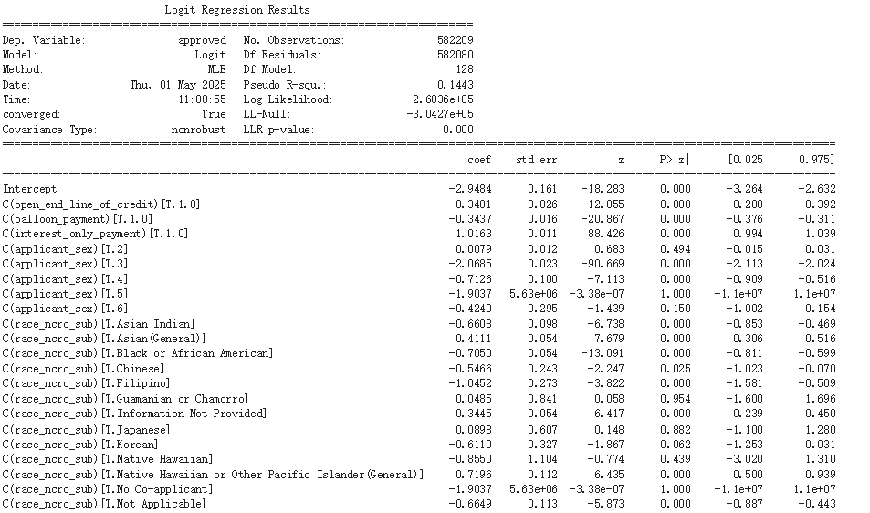

Slide 28
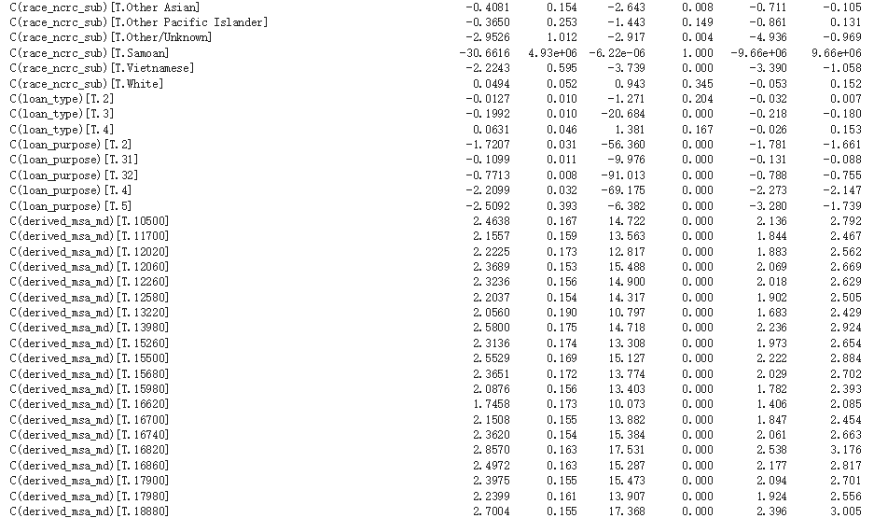

Slide 29
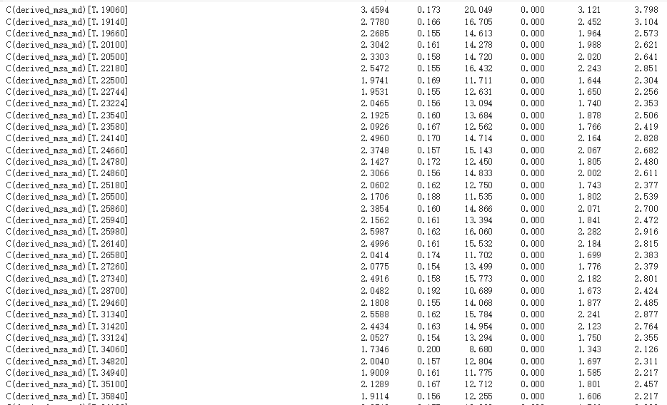

Slide 30
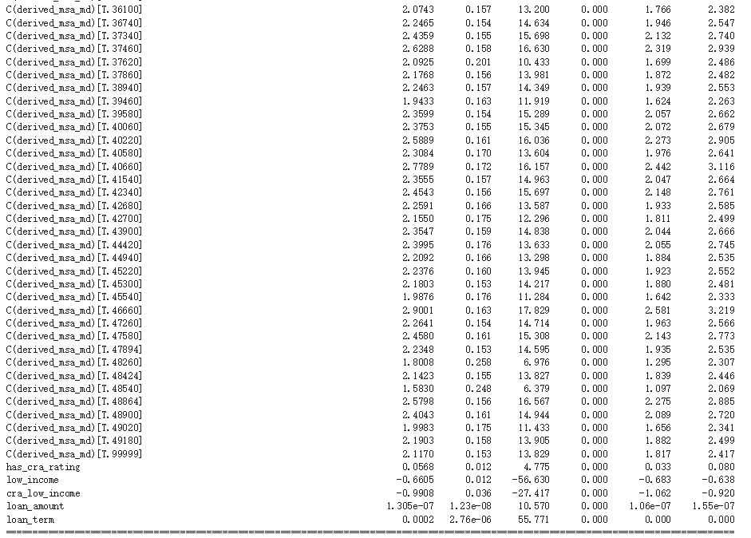

Slide 31
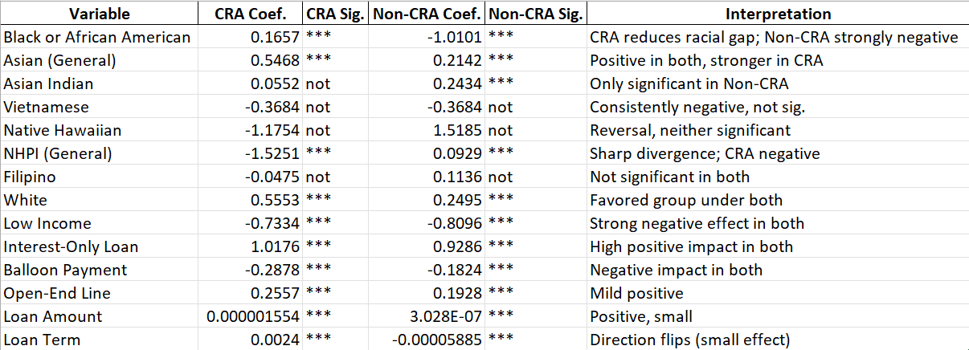
Appendix E: logistics Regression Comparison Table
( CRA vs Non CRA)

Slide 32
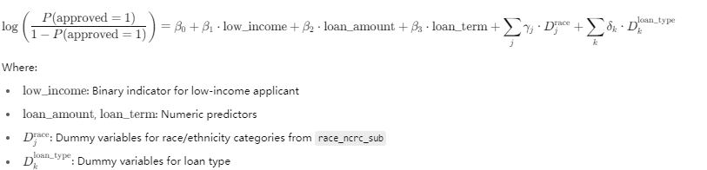

Slide 33
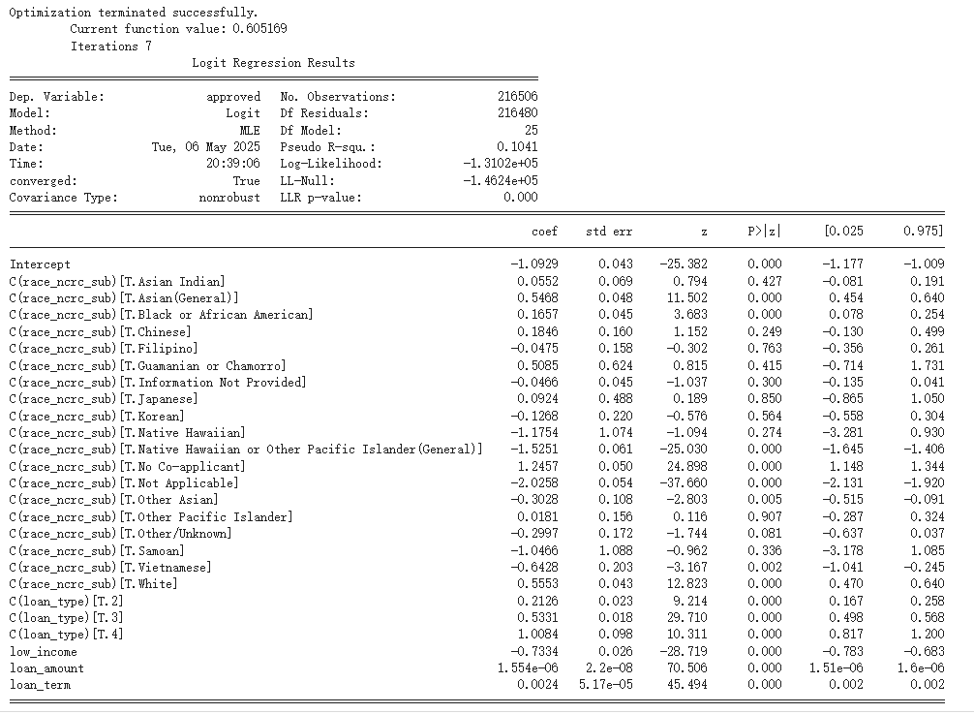
logistics Regression Comparison Table
( CRA)

Slide 34
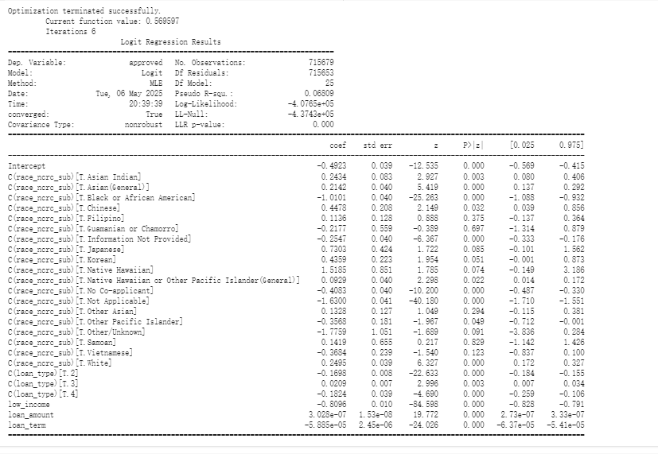
logistics Regression Comparison Table
(Non CRA)

Slide 35
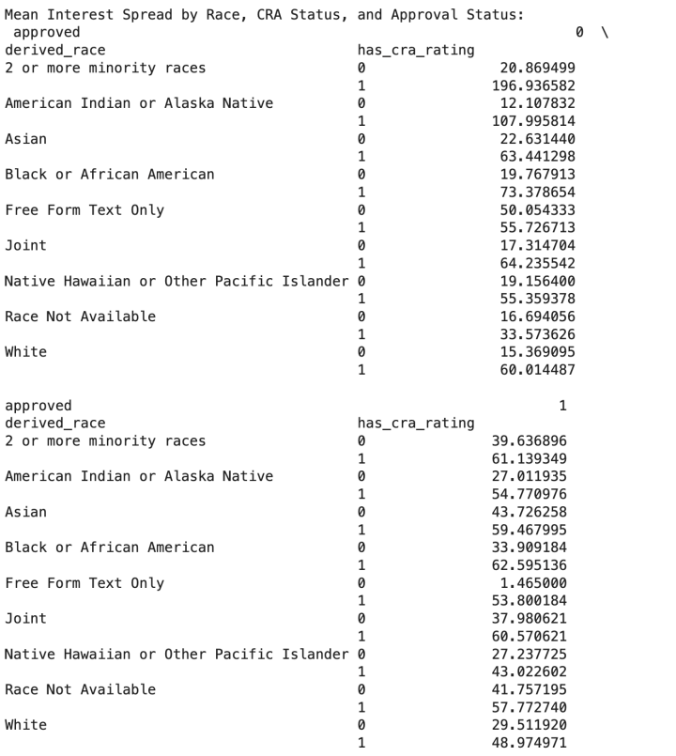
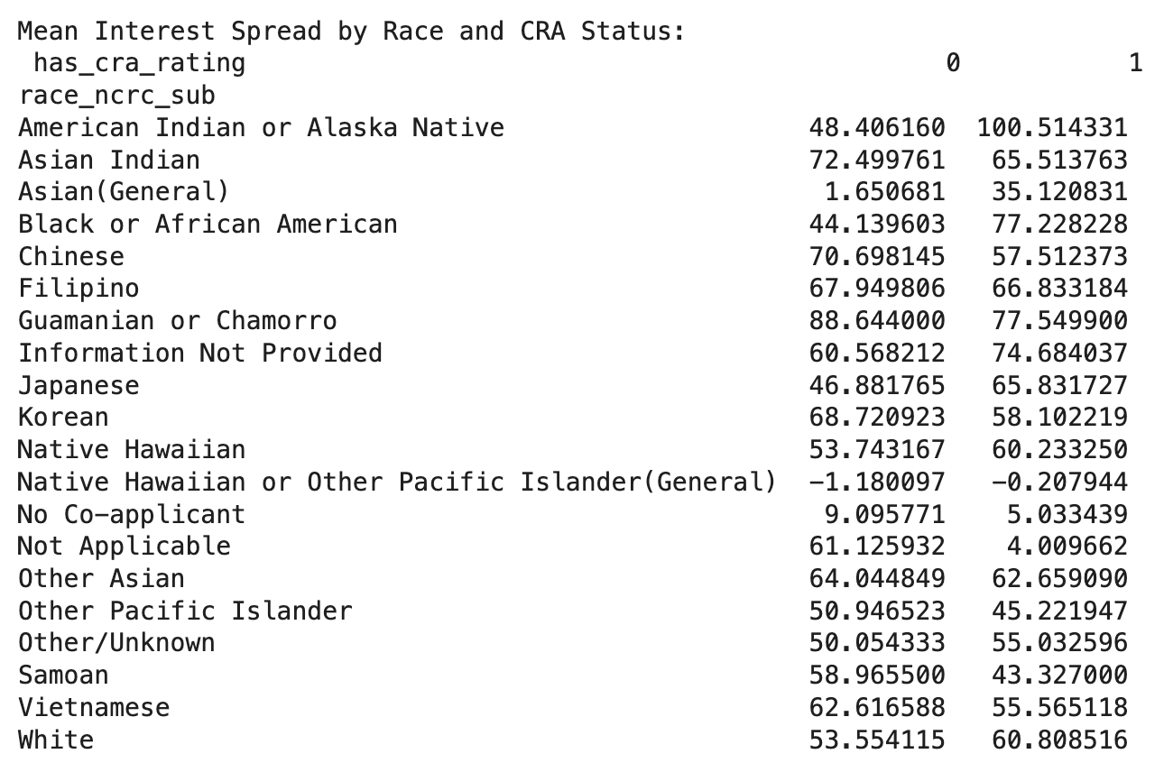
Notes:
NEED more cleared picture

